Slide 1
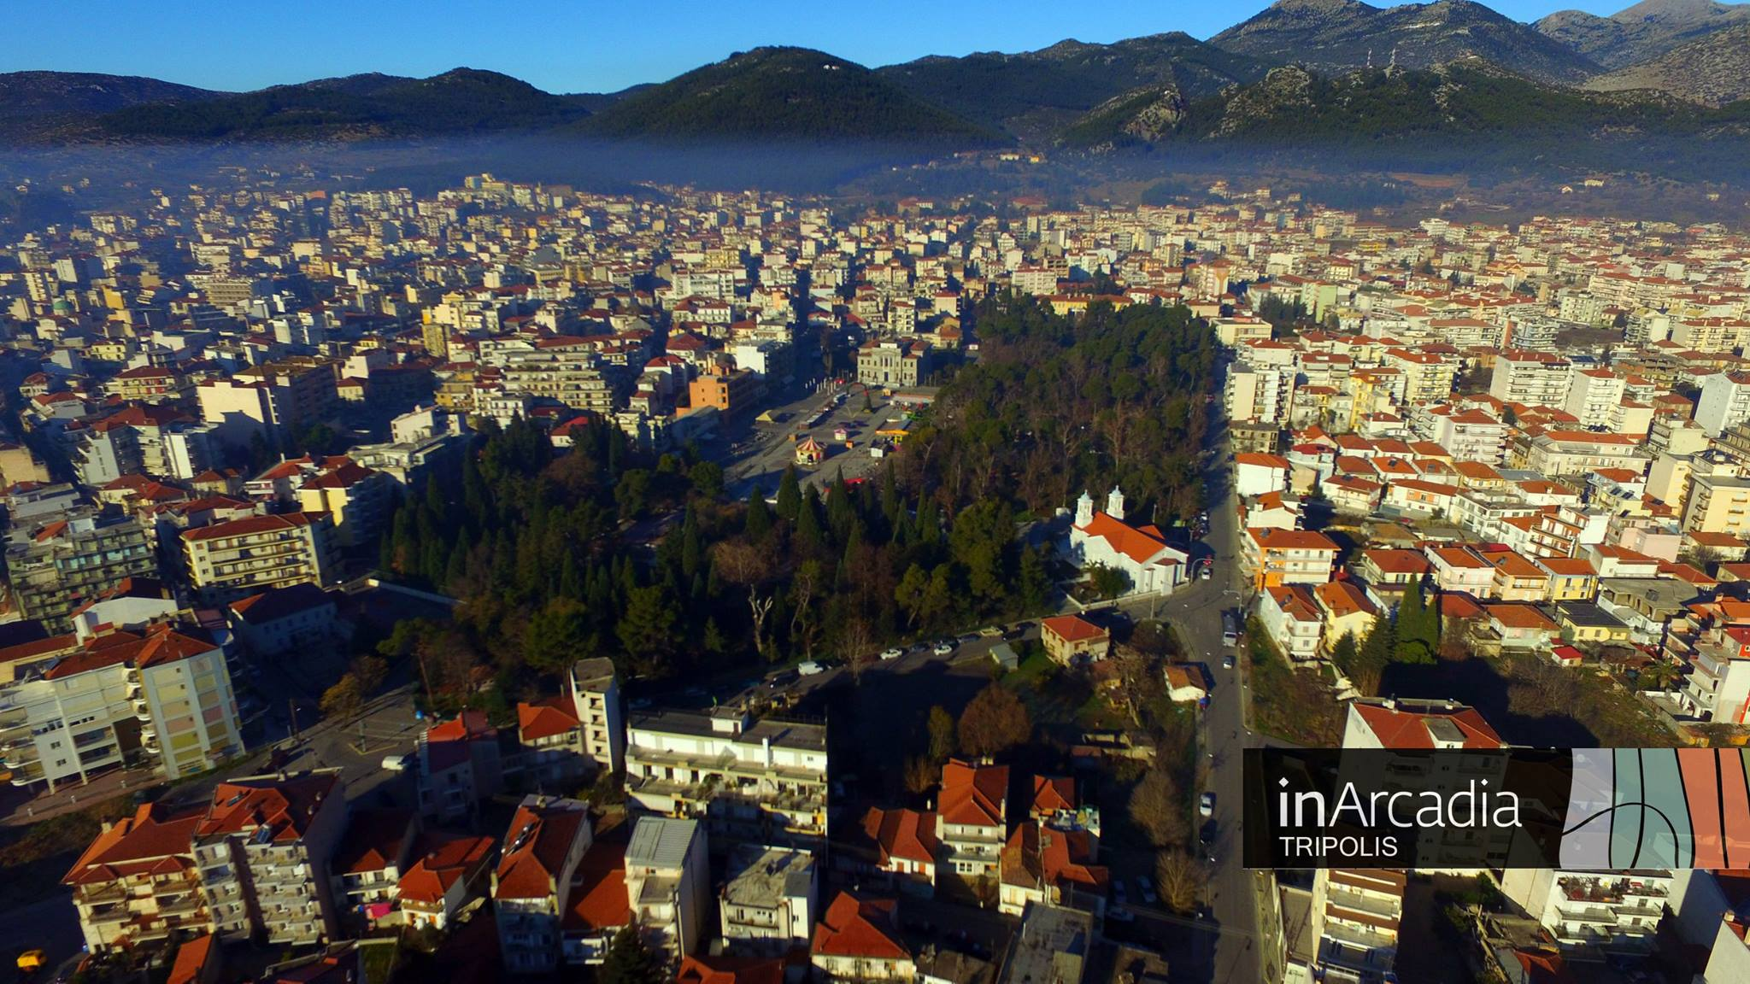
Tripolis’ Smart Specialization Strategy
Workshop [Code:12A90]:
Smart Specialization Strategy: from planning to funding
Wednesday , 12 /10/2016
Dimitrios PAVLIS, Mayor of the Municipality of Tripolis

Slide 2
…in the center of Peloponnesus…
…in the middle of Arcadian mountains…

Slide 3
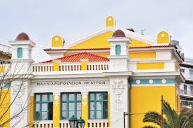
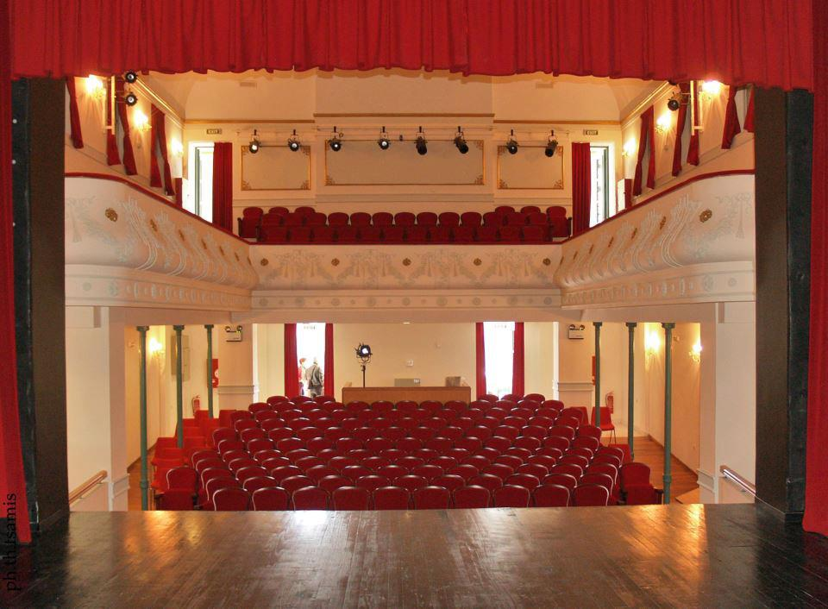
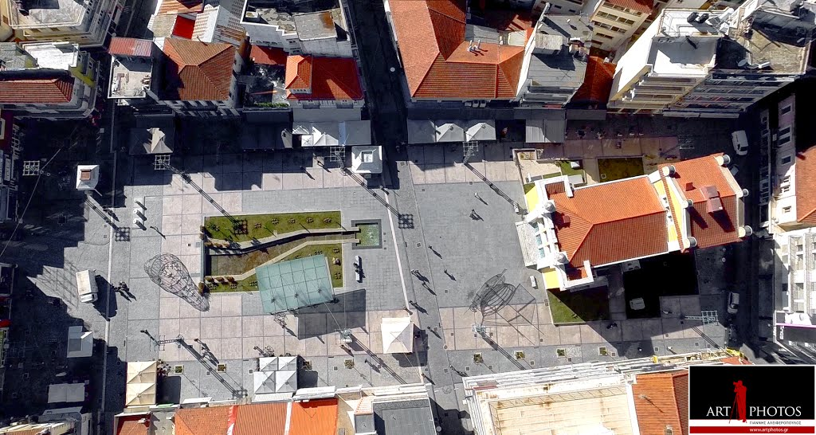
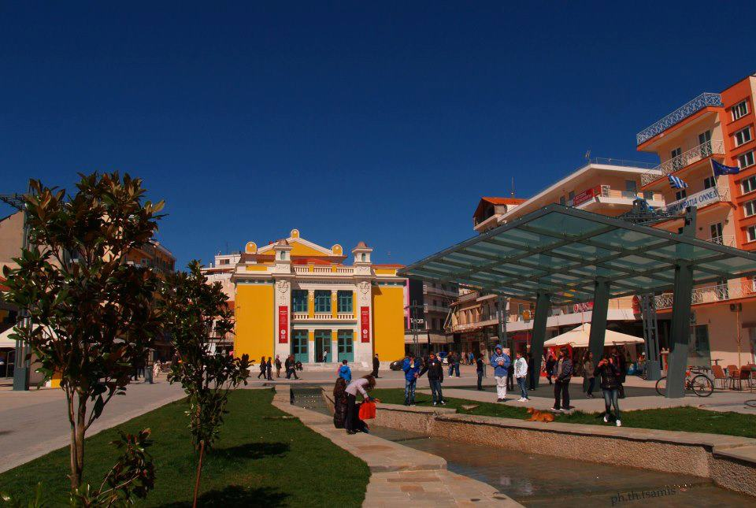
Challenges / Instruments
Strategic Alliances with main Stakeholders
Cooperation with the University of Peloponnese and other academic institutes
Twinning with European local authorities
Participation in European Networks
increase the active participation of citizens in the decision-making process
enhance youth employment
valorise the brand name “ARCADIA”
promote innovation
create synergies between urban and rural areas

Slide 4
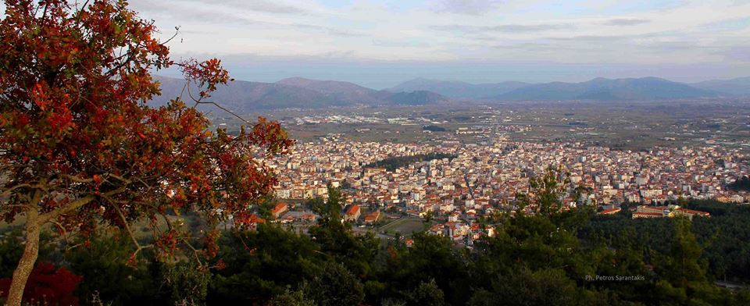
Activation of the 3 key elements
Local Authority
Bodies - stakeholders & citizens
Coordination/Consultation
R & D
Cooperation with scientific research
and academic institutions
Enterprises
Local Production
Identify and valorise potentials fields

Slide 5
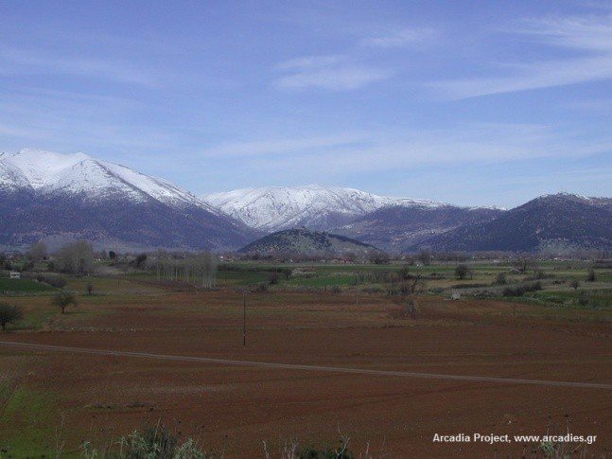
Basic elements of our Strategy
“Bottom-Up” method
Comprehensive and integrated approach
In close cooperation with the local community
Based on local needs and resources
Results - oriented
Each planned action has to:
Be based on the strategic vision
Be innovative
Be sustainable
Our overall vision: to make Tripolis, in the next five years, an attractive city for business, studies and leisure; a modern and smart Municipality, recycling and energy-saving friendly, in order to best serve the needs of its citizens and visitors.

Slide 6
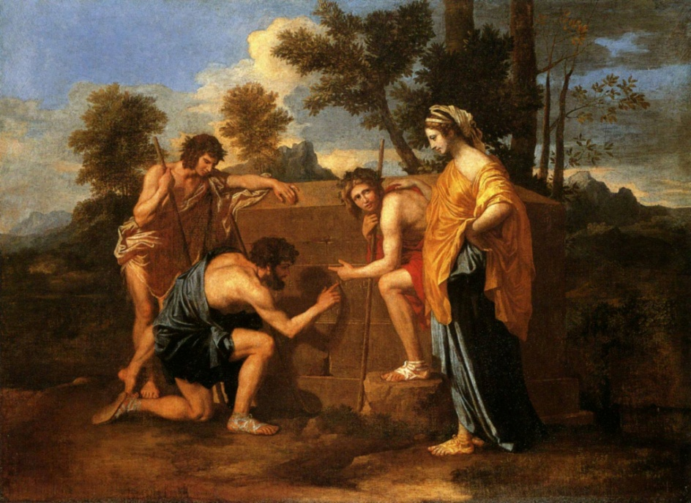
The brand name “ARCADIA”
Et in Arcadia Ego
Arcadia was the metropolis of important colonies in the ancient world
Nature, simplicity, innocence and romantism were significant to human life and enforced the basis of the modern european everyday life.

Slide 7
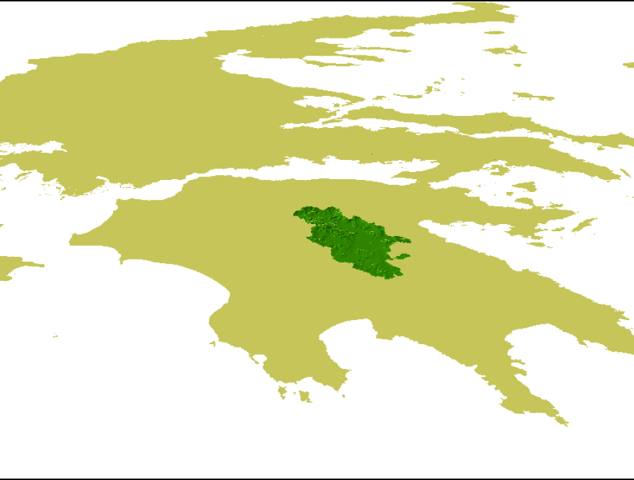
The Municipality of Tripolis… today
Action Plans EE: -Adding to SEAP (2013)
Funding Programs involved:
-JESSICA(2015) -Comenius: Participation of Tripolis’ Highschools (2010 -2015)
-Europe for Citizens (2012-2013)
Twin cities:
Municipality of Peine - Germany
Municipality of Paralimni – Cyprus
Municipality of Pafos- Cyprus
Municipality of Fore –France
Networks:
-Intercity Youth Network
-Biennale des jeunes créateurs de l’Europe et de la Méditerranée
-Urban Food Policy Pact
-Anna Lindh Foundation
-European Institute of Cultural Routes
-Mayors for Peace
-Citta Mediterranea della Musica
Population: 48.730 (2011)
Total area: 1.475.805 km²

Slide 8
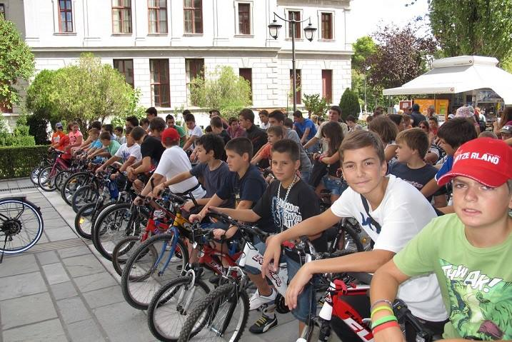
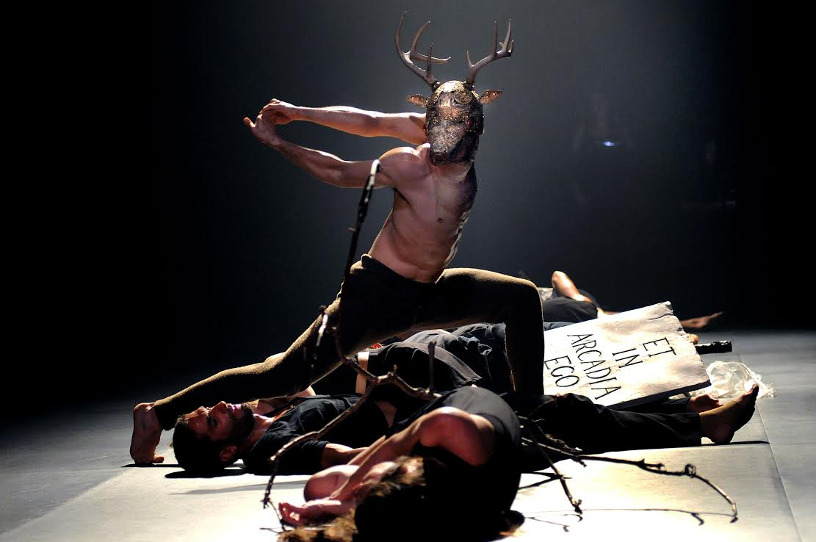
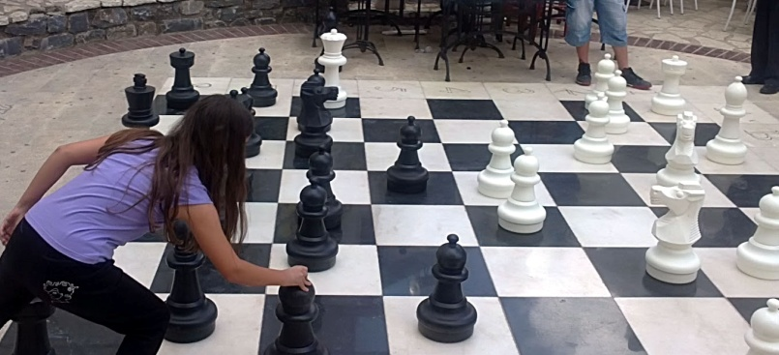
http://www.tripolis.gr/ http://www.tripolisarcadia2021.gr/index.php/el/ Τhank you for your attention

